Slide 1
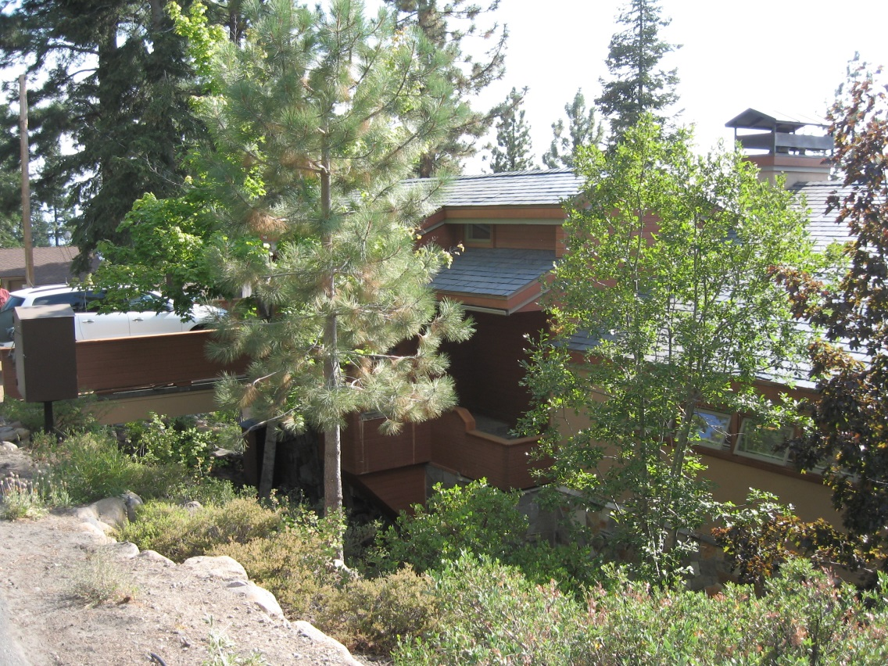
WPVAR18-0005 (Blaszky-Wittmann)
Washoe County Board of Adjustment
October 4, 2018

Slide 2
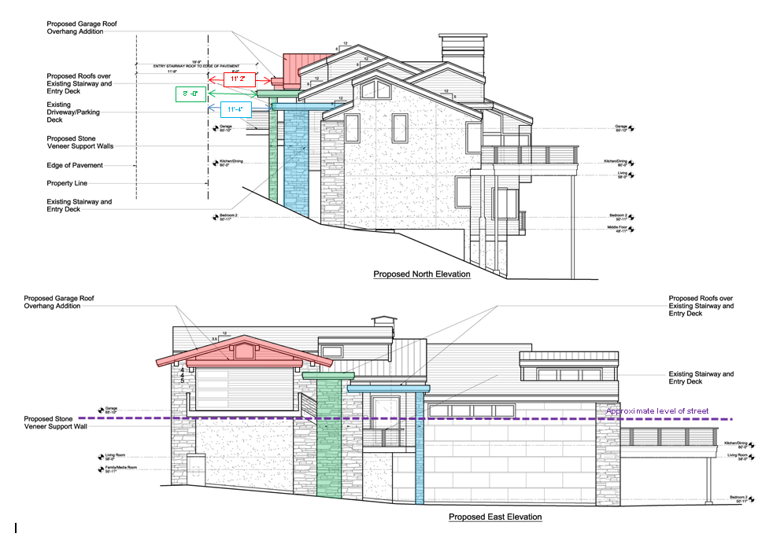
Request

Slide 3
Overview

Slide 4
Neighbor’s Comments
Neighbor's garage built to property line.
Subject property’s roof 8’ from property line and 19’ from edge of street.
Construction impacts – good neighbors
449 Fairview Blvd

Slide 5
Public Notice & CAB
Notice sent to 33 affected property owners
Incline Village/Crystal Bay CAB reviewed the application on September 4, 2018
CAB recommended approval
Neighbor at 449 Fairview expressed concern about construction activity and restriction of views

Slide 6
Reviewing Agencies
Washoe County Community Service
Planning Program
Building Program
Land Development
Washoe County Health District
North Lake Tahoe Fire Protection District
Incline Village General Improvement District
Public Utilities (NV Energy, SW Gas, Charter)

Slide 7
Variance Findings
Special Circumstances
No Detriment
No Special Privileges
Use Authorized

Slide 8
Possible Motion
I move that, after giving reasoned consideration to the information contained in the staff report and information received during the public hearing, the Washoe County Board of Adjustment approve Variance Case Number WPVAR18-0005 for Blaszyk-Wittmann with the Conditions of Approval included as Exhibit A for this matter, having made all four required findings in accordance with Washoe County Development Code Section 110.804.25

